Slide 1

Data-Driven Retention Strategy
Analyzing Employee Attrition & Enhancing Engagement for Junior Staff at Adecco India

Slide 2

Executive Summary
A comprehensive analysis of employee turnover across 1,470 staff records, highlighting key drivers and actionable interventions to retain junior talent.

Slide 3

Junior Attrition Rate
35.1%
Targeted Turnover Challenge
While Adecco India's overall company turnover stands at 16.1% (237 exits across 1,470 employees), attrition spikes to 35.1% for junior staff (Job Level 1 and age under 30), more than twice the company rate.
This concentrated attrition disrupts project delivery and raises recruitment and onboarding costs (about $8.2M across all 237 exits, under an assumed 0.6x annual-income replacement cost).
Junior Staff (Level 1, under 30)

Slide 4

Study Dataset & Scope
Single HR dataset: 1,470 employee records covering demographics, job level and role, satisfaction scores, pay, tenure, manager tenure and an overtime flag.
Department scope: Sales, Research & Development and Human Resources, across nine job roles and five job levels.
Overtime measure: the dataset has no daily in/out times, so overtime is measured with the OverTime flag (Yes/No), not hours per day.

Slide 5


Primary Drivers of Turnover
Overtime & Fatigue Burnout
Level 1 Early-Tenure Churn & Pay
Employees flagged for overtime show a 30.5% attrition rate, compared to 10.4% for those without overtime. At Level 1 the gap is wider: 52.6% versus 15.8%.
Level 1 staff with under 2 years at the company leave at 44.1% (vs 20.4% for 2+ years). Across all staff, pay matters too: income under 3,000/month 28.6% vs 11.5%; no stock options 24.4% vs 9.9%.

Slide 6






Secondary Risk Factors
Manager Tenure
Travel Frequency
Work Environment
Attrition reaches 28.3% among staff with 1 year or less under their current manager, dropping to 11.2% once tenure exceeds 3 years.
Frequent business travel is linked to 24.9% turnover, whereas non-travelling staff show a low 8.0% baseline.
Staff reporting low Environment Satisfaction (score 1) register a 25.4% attrition rate, versus 13.6% for scores 3-4.

Slide 7
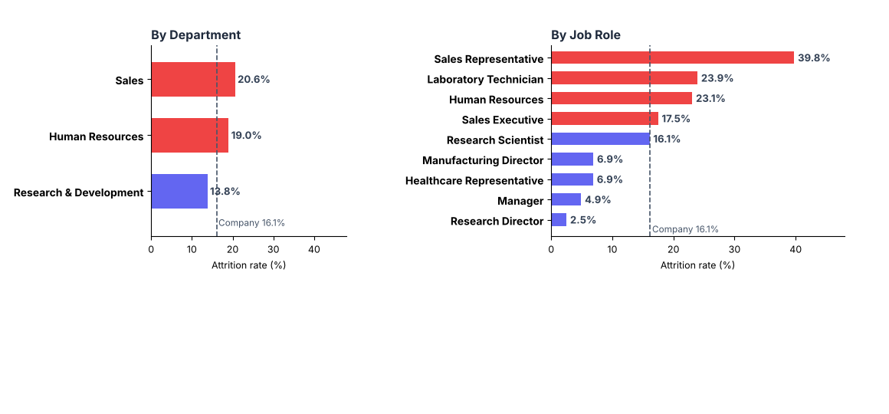
Attrition by Department and Job Role
Highest-risk roles: Sales Rep (39.8%), Lab Technician (23.9%), HR (23.1%). Company rate: 16.1%.

Slide 8
Quantitative Risk Factors
Demographic / Metric | High-Risk Cohort | Attrition Rate | Risk Level
Marital Status & Age | Single, Age < 30 Years | 41.2% | Critical
Overtime | OverTime = Yes | 30.5% | Critical
Level 1 + Overtime | Level 1 and OverTime = Yes | 52.6% | Critical
Manager Relationship | <= 1 Year with Manager | 28.3% | Critical
Early Tenure in Level 1 | < 2 Years at Company | 44.1% | High

Slide 9

Overtime & Burnout
Impact of Overtime
Employees on overtime leave at 30.5% versus 10.4% without it (2.9x). At Level 1 the rate is 52.6%. If overtime staff left at the no-overtime rate, exits would fall by about 84 of 237 (an association, not proven causation).
Capping overtime and scheduling recovery days targets the cohort with the largest, company-controlled risk gap in this data.

Slide 10




Strategic Action Plan
Q2 - Pay & Careers
Q4 - Hybrid Work
Review pay and stock options for low-income Level 1 staff; clear L1-L2 path.
Offer 2-3 remote days for staff commuting over 10 km; cap frequent travel.
Q1 - Workload Caps
Q3 - Mentorship
Institute weekly overtime alerts and mandatory recovery days after peak periods.
Mandate 30-60-90 day onboarding and skip-level reviews in year one.

Slide 11



Core Action Pillars
Workload Capping
Growth Mentorship
Hybrid Flexibility
Overtime alerts and recovery days to reduce burnout in overtime-heavy teams.
Structured onboarding and 1-on-1 career mapping to boost junior engagement and loyalty.
Flexible work schedules to offset long commutes and travel stress.

